Slide 1
Detection of Hate Speech using BERT and Hate Speech
Word Embedding with Deep Model
Hind Saleh, Areej Alhothali, and Kawthar Moria
Presented By
Refat Ishrak Hemel
ID: 3810002
Notes:
Hello, everyone. I'm presenting a research paper titled "Detection of Hate Speech using BERT and Domain-Specific Word Embedding with Deep Model" by Hind Saleh et al, published in Applied Artificial Intelligence in 2023.
This paper addresses a critical problem in our digital age which is automatically detecting hate speech on social media platforms with high accuracy while accounting for coded language that hate communities use to evade detection.

Slide 2
Outlines:
Problem Overview and Background
Methodologies: Two Approaches
Experimental Results and Findings
Importance of Domain-Specific Embeddings
Explainability Analysis
Conclusion
Notes:
In the next 10 minutes, I'll walk you through the problem, the two approaches they investigated, their experimental results, and why domain-specific embeddings matter. We'll also look at explainability analysis and the conclusion.

Slide 3
Why Hate Speech Detection?
60% of global population uses social media (4.54 billion)
53% of Americans encounter online harassment and hate
21% of students frequently encounter hate speech
Hate communities use coded words, abbreviations, misspellings to evade detection
Automatic detection is essential for safer digital environments
Notes:
Let me start with context. 60% of the global population—that's 4 and a half billion people—uses social media. According to studies, 53% of Americans have encountered online harassment and hate speech. Even more concerning, 21% of students frequently encounter hate speech on social media.
Social media platforms have become a breeding ground for hate speech targeting people based on race, religion, gender, sexual orientation, and other characteristics. The negative impact on communities is significant—it can radicalize young people and incite violence.
The authors aim to provide an automated solution using machine learning and deep learning to detect this harmful content at scale.

Slide 4
Detection Challenges
Coded Words: Innocent words used maliciously (e.g., "Google" for dark-skinned people)
Intentional Misspellings: f*ck, r*pe to evade automated filters
Abbreviations: Commonly used by hate communities
Context Dependency: Same words can be hateful or benign depending on context
Subjectivity: Identifying hate speech is inherently subjective
Notes:
Now, why is this problem challenging? Hate communities deliberately use coded language. For example, they might use the word "Google" to refer to dark-skinned people. They use intentional misspellings like "fck" or "rpe" to bypass automated filters. They use abbreviations and fragments.
Additionally, the same words can be hateful or innocent depending on context. And identifying hate speech is inherently subjective—two humans might disagree on whether something is hateful.
This is where domain-specific word embeddings come in. If we train our embedding models on actual hate speech data, they'll learn the semantics of coded words and misspellings that general-purpose models completely miss.

Slide 5
BACKGROUND
Converts words into numerical vectors capturing semantic meaning and context
Word2Vec: Prediction-based model trained on massive corpus
GloVe: Count-based model using word co-occurrence statistics
Domain-Specific: Trained on hate speech data for contextual accuracy
Notes:
Let me briefly explain word embeddings. Word embeddings convert words into numerical vectors that capture semantic meaning and context. There are several types:
Word2Vec is a predictive model that uses local context to learn word embeddings through tasks like predicting a word from its context or predicting the context from a word , trained on massive corpora like Google News
GloVe is a count-based model that learns by factorizing a global word-word co-occurrence matrix, directly using global statistics from the entire corpus
Domain-Specific embeddings are trained on data from a specific domain—in this case, hate speech from Twitter and hate websites
The key insight: if you train embeddings on hate speech data, the model learns what words mean within the hate community, not what they mean in general.

Slide 6
Approach 1: Domain-Specific BiLSTM
Key Innovation: Custom hate speech embeddings (HSW2V) with BiLSTM classifier
Data: 1,048,563 sentences from hate speech datasets + Twitter
Feature: Domain-specific Word2Vec vectors (300-dimensional)
Classifier: Bidirectional LSTM for context preservation
Notes:
The paper investigates two approaches. Approach 1 combines domain-specific embeddings with a BiLSTM deep learning classifier.
They created their own embedding model called HSW2V (Hate Speech Word2Vec) trained on 1.048 million sentences from available hate speech datasets plus data they collected from Twitter using hate keywords and hateful accounts.
For classification, they use BiLSTM—Bidirectional LSTM—which processes text in both forward and backward directions, preserving long-range dependencies and context.

Slide 7
Approach 2: BERT Transfer Learning
Key Innovation: Pre-trained bidirectional transformers with fine-tuning
Foundation: Trained on 3.4 billion+ words (Books Corpus + Wikipedia)
Bidirectional: Reads context from both directions
Fine-tuning: Adapted for hate speech binary classification
Notes:
Approach 2 uses BERT—language model which is based on transformers.
BERT is a pre-trained language model trained on enormous amounts of data: 3.4 Billions+ words from book corpora and Wikipedia. BiLSTM processes text sequentially both forward and backward but primarily models sequential dependencies. BERT, using a self-attention mechanism, looks at the entire sequence simultaneously to understand the context of a word from both its left and right sides at once. This allows BERT to grasp more nuanced and complex semantic relationships.
The authors fine-tune BERT for hate speech binary classification. one can simply add a classification layer on top and train it on hate speech data.

Slide 8
Key Findings: Performance Comparison
Approach 1 (Domain-Specific BiLSTM)
81%-95% F1-Score
Excellent for detecting coded words and abbreviations
Approach 2 (BERT)
85%-96% F1-Score
Superior performance due to massive training corpus
Notes:
So Approach 1 achieves 81% to 93% F1-score depending on the dataset, while Approach 2 achieves 85% to 96% F1-score. So, There is a 1 to 4-point difference.
The author claims that The main reason for that is the corpus size. HSW2V is trained on 1 million sentences. BERT is trained on over 3.3 billion words. Pre-trained models perform better with more data.
However, the gap is surprisingly small—only 1 to 4 points—given the massive difference in training data. This demonstrates the power of domain-specific embeddings.

Slide 9
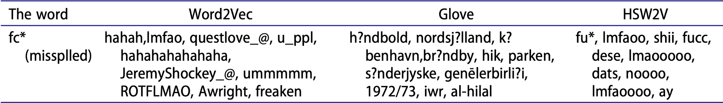
Why Domain-Specific Embeddings Matter
Word2Vec: Failed to retrieve similar hate words
GloVe: Retrieved irrelevant results (mostly diacritical marks)
HSW2V (Ours): Successfully identified: fu*, lmfaoo, shii, fucc, noooo
Insight: Domain-specific models capture hate community semantics
Notes:
Here's a compelling example from the paper. They tested word similarity with a misspelled hate word: "fc*" (a deliberately obscured slur).
Word2Vec retrieved: irrelevant words like "hahahahahaha", "questionlove", "freaken"—completely wrong
GloVe retrieved: diacritical marks and non-English text—also wrong
HSW2V retrieved: fu*, lmfaoo, shii, fucc, dats, noooo—exactly what they wanted
This is the critical insight: domain-specific embeddings understand hate community semantics.General models fail because hate speech words and their misspellings are rare in Wikipedia and books. They only appear frequently in hate speech corpora.

Slide 10
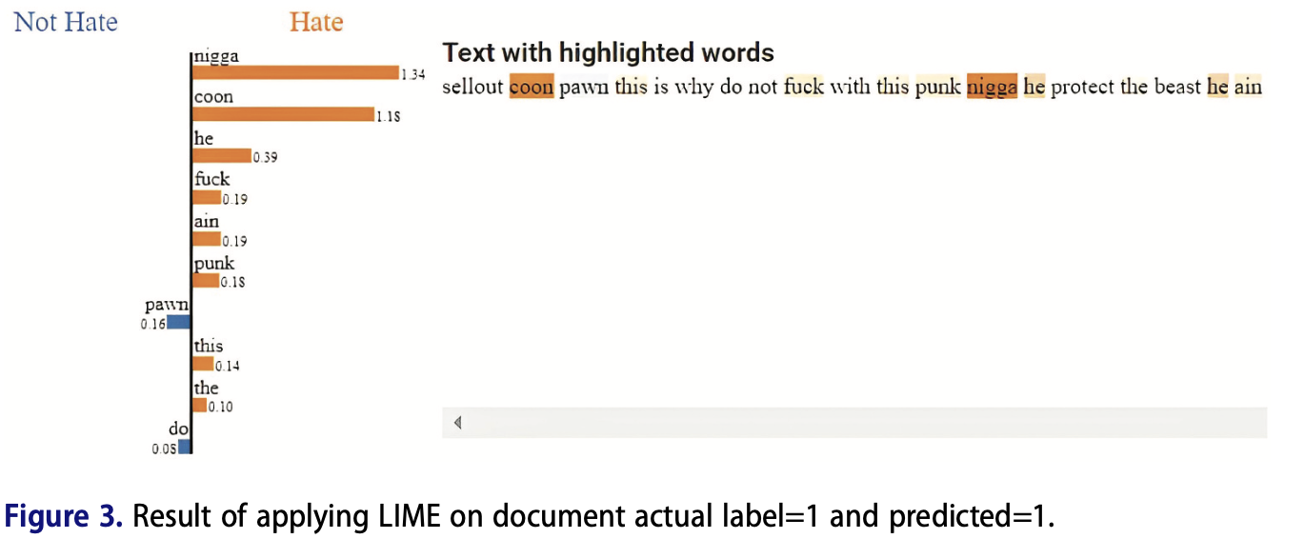
Explainability Analysis
Fig: True Positive
Notes:
The paper also analyzed model explainability using LIME—Local Interpretable Model-agnostic Explanations. This shows which words influenced the classifier's decision.
For example this is the case for True Positive. The orange/yellowish colored words influences towards positive hate speech class and blue colored words influences the model to predict it as not hate speech.

Slide 11
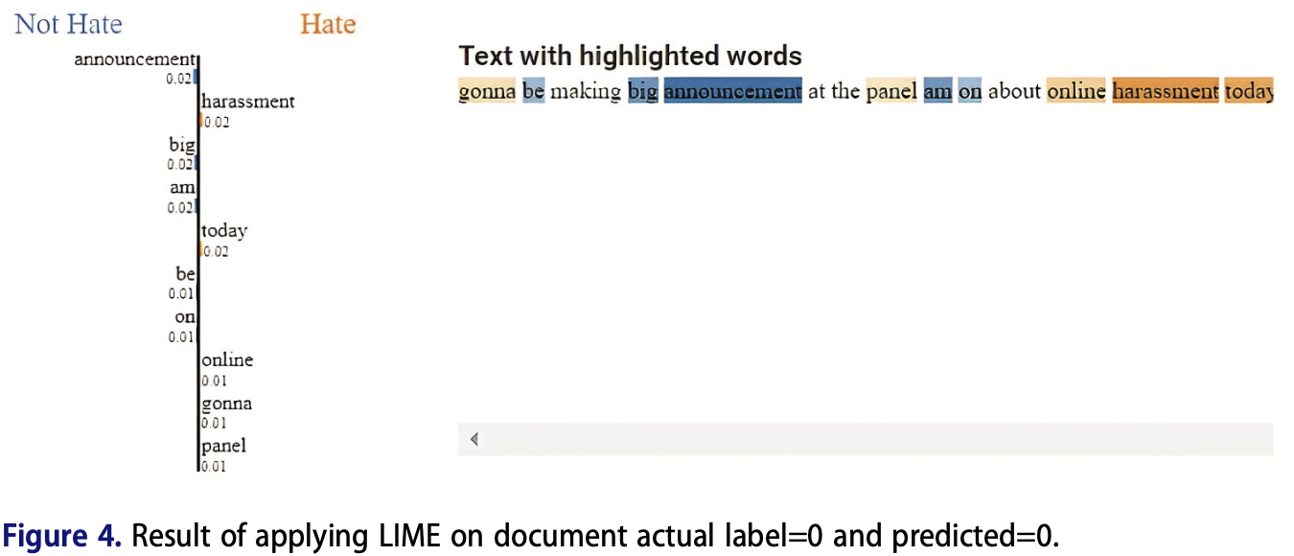
Explainability Analysis
Fig: True Negative
Notes:
In the previous example there were very few blue colored words. In the case of this True negative example there are more blue colored words. Even though having more blue colored words the word harassment and today influenced the model towards hate. Clearly it is not.

Slide 12
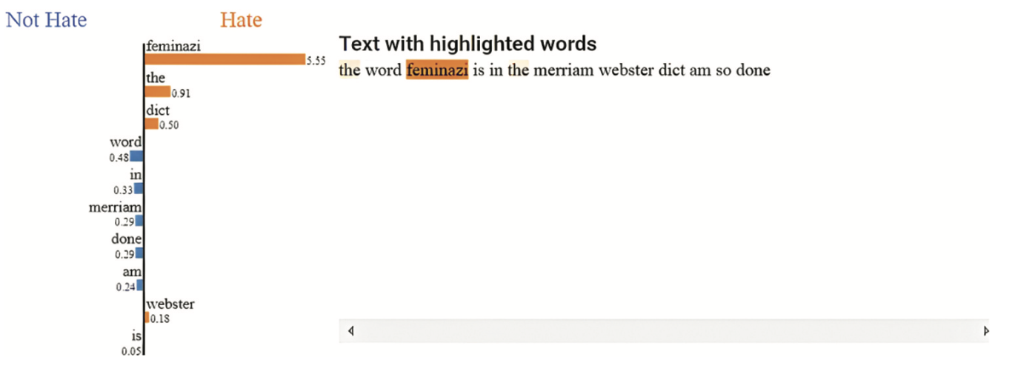
Explainability Analysis
Fig: False Positive
Notes:
For false positives, the model sometimes flagged neutral text as hate. For example, the word "feminazi" triggered a misclassification even in a neutral context. This shows the model is overly sensitive to certain terms.

Slide 13
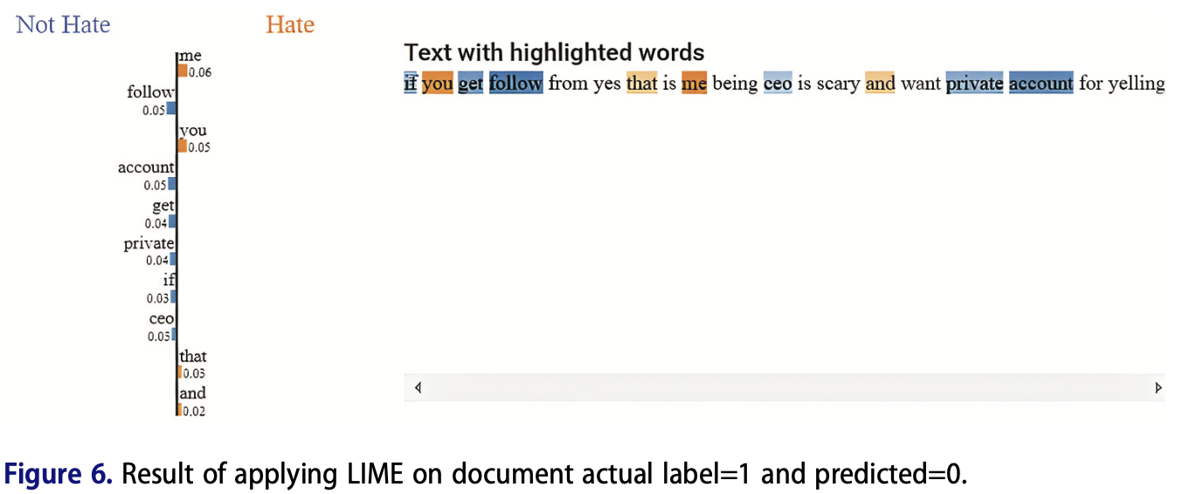
Explainability Analysis
Fig: False Negetive
Notes:
For false negatives, interestingly, the model sometimes is more accurate than human annotators. The subjective nature of hate speech means a sentence that humans might call hateful could be contextually benign.

Slide 14
Research Contributions
Developed unsupervised domain-specific word embedding (HSW2V) for hate speech
Compared domain-specific vs. domain-agnostic embeddings empirically
BiLSTM with HSW2V: Achieves good performance compared to its small training data.
Notes:
The paper makes four key contributions:
Developed HSW2V—an unsupervised domain-specific embedding model specifically for hate speech
Compared domain-specific vs. domain-agnostic embeddings systematically
BiLSTM with HSW2V achieves good performance compared to its small training data.

Slide 15
Key Takeaways
BERT provides superior feature extraction with pre-trained bidirectional context
Domain-specific embeddings excel at detecting coded words and misspellings
Large training corpus significantly improves pre-trained model performance
Combining approaches yields best results: transfer learning + domain knowledge
Notes:
What's the takeaway? BERT provides superior performance because it's bidirectional and trained on massive data. But domain-specific embeddings have a unique advantage—they excel at detecting coded words and intentional misspellings that generic models miss.
The size of the training corpus matters significantly for pre-trained models. And importantly, the best approach combines transfer learning with domain-specific knowledge—not one or the other.
The authors conclude that it's valuable to build large pre-trained models from domain-specific content, especially for specialized tasks like hate speech detection.

Slide 16
Thank you for your attention!

